Slide 1
Neighbourhood Policing
Fighting Crime
Protecting People

Slide 2
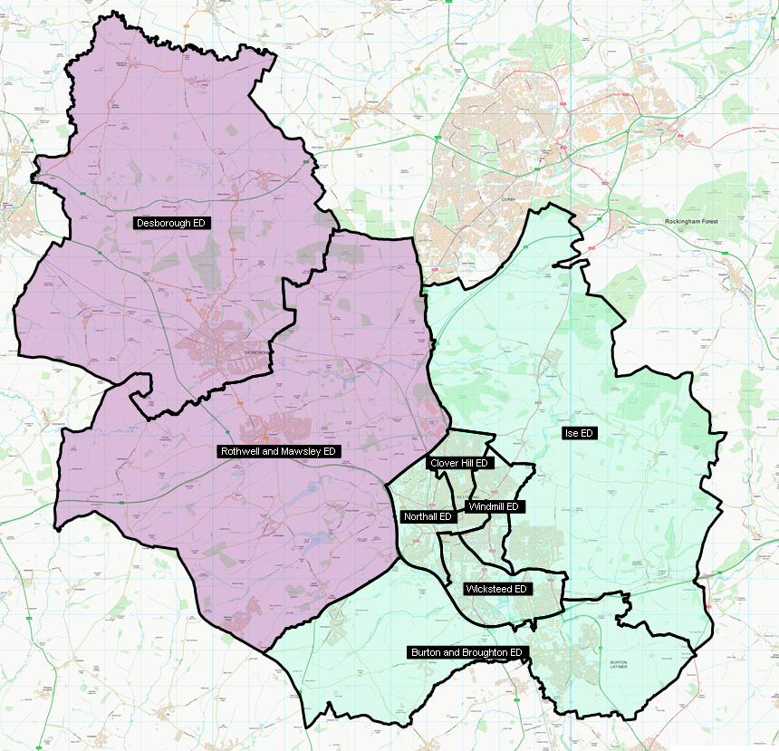
Kettering Sector
NK 1- Kettering Northall
Sgt 1349 Walsh
PC 23 Booth
PC 1644 Fotheringham
PC 1603 Underwood
PC 1576 Maltby
PC 1491 Fenwick-Smith
PC 1690 Barry
PC 1482 Smith
PCSO 7144 Cotter
PCSO 7087 Brown
Clover Hill
Sgt 1662 Callaghan
PC 1638 Denton
PC 632 Orton
PCSO 7143 Chachulska
Windmill
Sgt 1662 Callaghan
PC 1523 Batten
PC 418 Bangs
PC 1125 Dickens
PCSO 7095 Loveday
PCSO 7045 Coles – Schools Liaison Officer
NK 6- Desborough
Sgt 1156 Quinlan
PC 216 Ryan
PCSO 7050 Ellerby
Covering LAP
Kettering Urban & Rural
Sector Inspector
X0692 Matt Rock
Sector Co-ordinator
Emily Philp
Member of Parliament
Rosie Wrighting
Councillors
TBC
NK 3- Ise
Sgt 1156 Quinlan
PC 1652 Donald
PCSO 7114 Meszes
NK 5- Rothwell & Mawsley
Sgt 1156 Quinlan
PC 509 Vickery
PCSO 7036 Scott
NK 2- Wicksteed
Sgt 1349 Walsh
Sgt 1662 Callaghan
PC 1201 Hill
PCSO 7130 Bowes
PCSO 7191 Duggan
NK 4- Burton & Broughton
Sgt 1156 Quinlan
PC 310 Jones
PCSO 7095 Goodes

Slide 3
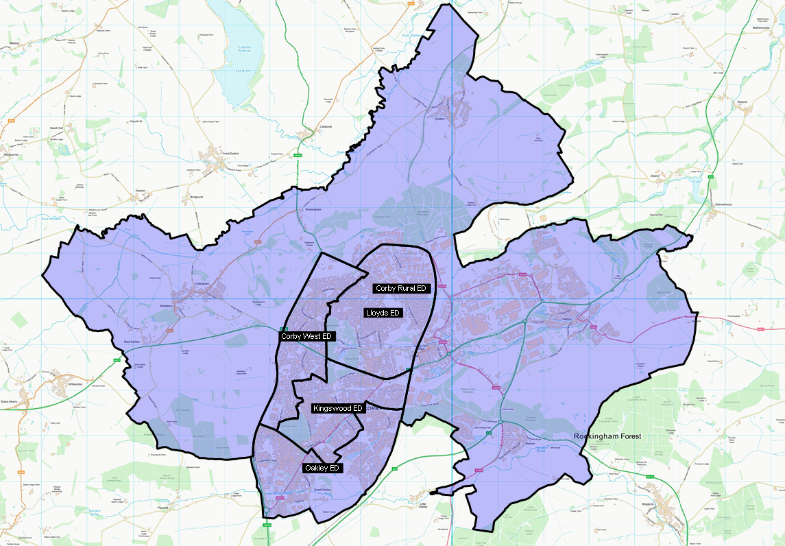
Corby Sector
NC 1- Corby Town
Sgt 942 Cox
Sgt 142 McClean
PC 195 Hallett
PC 309 Campbell
PC 1477 Worthington
PC 1479 Carter
PC 100 Buchanan
PC 925 Smith
PC 970 Wood
PC 1631 Thomas
PCSO 7149 Devlin
PCSO 7009 Panther
PCSO 7030 Asante-Ampaduh
PCSO 7045 Coles – Schools Liaison Officer
NC 2- Corby Industrial and Rural
Sgt 942 Cox
Sgt 142 McClean
PC 1640 Crabb
PCSO 7074 Wallace
Covering LAP
Corby
Sector Inspector
X 692 Matt Rock
Sector Co-ordinator
Emily Philp
Member of Parliament
Lee Barron
Councillors
TBC

Slide 4
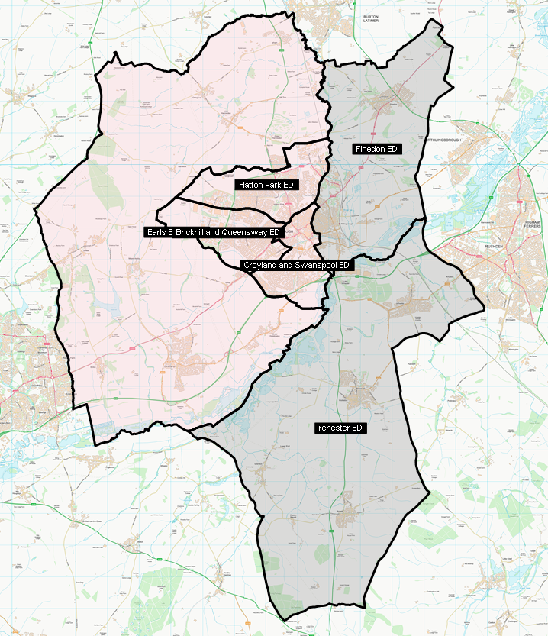
Wellingborough Sector
NW 3- Finedon ​
Sgt 799 Nawaz
PC 109 Manton
PC 135 Wigmore
PCSO 7059 Cross
NW 5- Earls Barton ​
Sgt 799 Nawaz
PC 1285 Foster ​
PCSO 7059 Cross ​
Covering LAP
Wellingborough Urban & Rural
Sector Inspector
Andy Maher
Sector Co-ordinator
Victoria Purcell
Member of Parliament
Gen Kitchen
Councillors
TBC
Wellingborough North​
Sgt 444 Chambers ​
PC 1366 Tyers ​
PC Vacancy
PC 1578 Owen
PC Vacancy
PCSO Vacancy
PCSO 7195 Turney
Wellingborough South​
Sgt P286 Glenn Thompson
PC 1118 Wright- Schools
PC 586 Unsworth
PC 956 Legg
PC Vacancy
PC 1729 Richardson
PC 1668 Wileman
PC 1639 Morris
PC 1888 Jones
PCSO 7180 Seabrook
PCSO 7083 Dobson
PCSO Vacancy
PCSO Vacancy
PCSO Vacancy
NW 4- Irchester ​
Sgt 799 Nawaz
PC 239 Norman ​
PCSO 7163 Fenner ​

Slide 5
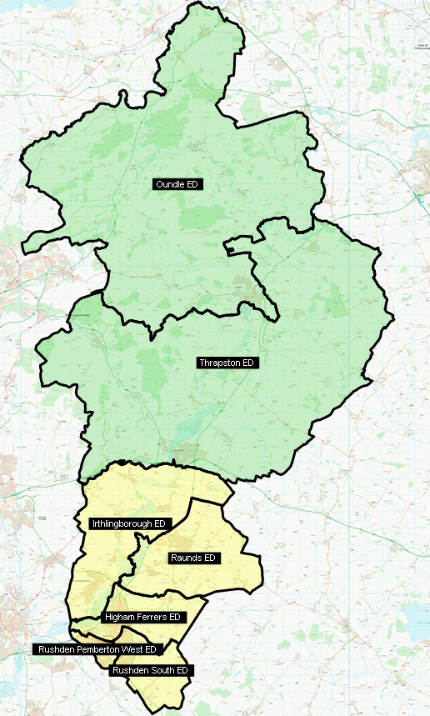
East Northants Sector
EN 5- Oundle
Sgt 799 Nawaz
PC 441 Morgan
PCSO 7090 Pereira
EN 4- Thrapston
Sgt 799 Nawaz
PC 80 Holmes
PCSO 7073 Butter
Covering LAP
East Northamptonshire Urban & Rural
Sector Inspector
Andy Maher
Sector Co-ordinator
Victoria Purcell
Member of Parliament
Lee Barron
Gen Kitchen
Councillors
TBC
EN 3- Irthlingborough & Raunds
Sgt 888 Goodwin
PC 991 Bristow
PC Vacancy
PCSO 7186 Burrows
PCSO Vacancy
EN 1- Rushden
Sgt 888 Goodwin
PC Vacancy
PC 1337 Barnes
PC 682 Bennett
PC Callum Hurst
PC 1489 Robinson
PC 511 Warren
PCSO 7098 Littleton
PCSO 7209 Thaseen
PCSO Vacancy
EN 2- Higham Ferrers
Sgt 888 Goodwin
PC 621 Green
PCSO 7007 Page

Slide 6
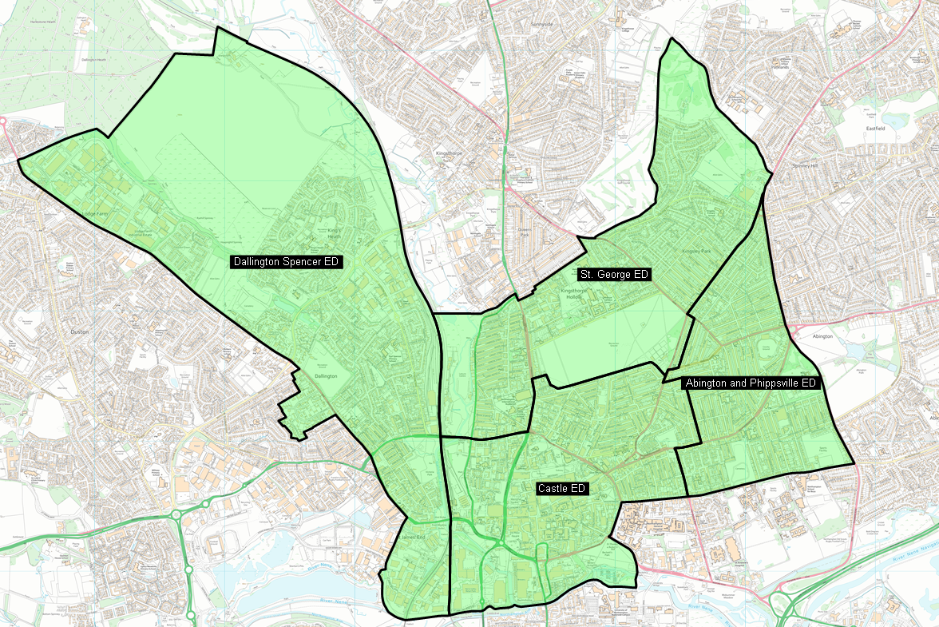
Northampton Central Sector
Dallington Spencer
Sgt 22 Lindsay
PC 1702 Spencer
PC 1490 Walls
PC 1497 Lowe
PC 1749 Cox
PCSO 7173 Emberton
PCSO 7021 Pole
PCSO 7110 Garnett
Covering LAP
N4
Sector Inspector
Nic Davis-Lyons
Sector Co-ordinator
Clare Tinston
Member of Parliament
Lucy Rigby
Mike Readers
Councillors
Castle
Jamal Alwahabi / Enam Haque / Danielle Stone
Dallington Spencer
Rufia Ashraf / Gareth Eales / Terrie Eales
Abington & Phippsville
Bob Purser / Zoe Smith / Walter Tarasiewicz
St George
Muna Cali / Catherine Russell / Winston Strachan
Castle
Sgt 949 Dilley
PC 1280 Stone
PC 920 Hogarth
PC 1947 Willis
PC 1972 Stirling
PC 1169 Patel
PCSO 7192 Church
Sgt 378 Williams
P1862 Davies
P1720 Yates
PC 1980 Skevington
PC 960 Perch
PC 1762 Habeeb
PCSO 7174 Potter
PCSO 7025 Eales
St George,
Abington & Phippsville
Sgt 841 Brooks
PC 1226 Wyburn
PC 1226 Stone
PC 1492 Govind
PC 1298 Noon
PC 1140 Nebbitt
PC 1470 Golby
PCSO 7016 Coote
PCSO 7096 Singh
UoN
Sgt 1688 Abbasi
PC 493 Juland
PC 125 Jones
PC 748 Allery

Slide 7
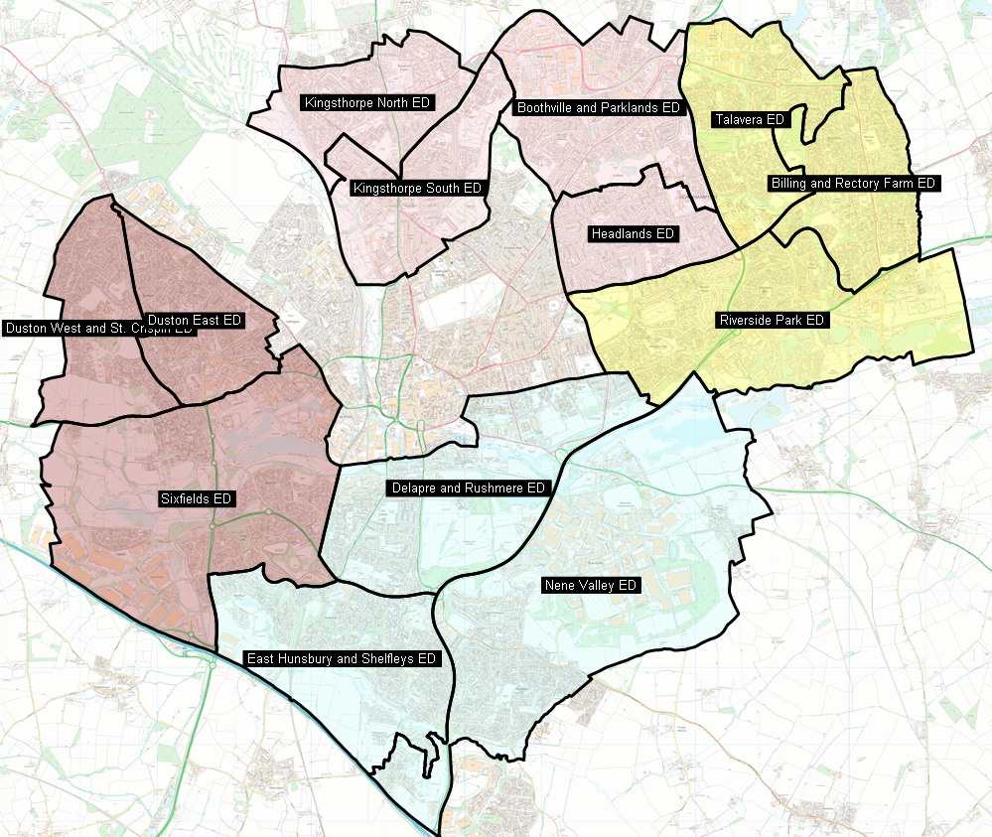
Northampton Suburban Sector
N5 - Kingsthorpe, Headlands & Boothville
Sgt 1338 Jeffries
PC 1981 Hilton
PC 701 Cottle
PC 1500 Massey
PC 1480 Barclay
PCSO 7196 Bednarczyk
PCSO 7198 Barber
PC 7150 Freeman
N1 - East Northampton
Sgt 1254 Moston
PC 687 Ballin
PC 542 Jipa
PC 1895 Lynch
PC 889 Scott
PC 373 Izzard
PC 1747 Morris
PCSO 7072 Harrison
PCSO 7013 Hoadley
PCSO 7125 Nowell
PCSO 7057 Whiting
PCSO 7022 Turner
Covering LAP
N1, N2, N3 and N5
Sector Inspector
Scott Farrant
Sector Co-ordinator
Clare Tinston
Member of Parliament
Lucy Rigby/Mike Readers
Councillors
Billing & Rectory Farm
Paul Clark / James Hill / Keith Holland-Delamere
Boothville & Parklands
Mike Hallam / Jamie Lane / Laura Stevenson
Delapre & Rushmere
Raymond Connolly / Julie Davenport / Emma Roberts
E Hunsbury & Shelfleys
Pinder Chauhan / Andre Gonzalez De Savage / Suresh Patel
Headlands
Koulla Jolley / Paul Joyce / Mark Hughes
Kingsthorpe North
Aziz Rahman / Michael Brown / Sam Rumens
Kingsthorpe South
Harry Barrett / Cheryl Hawes / Sally Beardsworth
Nene Valley
Lizzy Bowen / Phil Larratt / Jonathan Nunn
Riverside Park
Penelope Flavell / Stephen Hibbert / Andrew Kilbride
Talavera
Nazim Choudary / Janice Duffy / Dennis Meredith
Sixfields
Imran Ahmed Chowdhury / Brian Sargeant / Nick Sturges-Alex
Duston East
Paul Dyball / Nigel Hinch / Greg Lunn
Duston West & St Crispins
Matt Golby / Anna King / Jake Roberts
N3 - Duston and Sixfields
Sgt 986 O’Connor-Frisby
PC 1691 Chamberlain
PC 1496 Knowles
PC 1483 Cardell
PC 148 Walker
PCSO 7101 Pennington
PCSO 7069 Scarsbrook
N2 - Delapre / South Northampton
Sgt 1112 Liddle
PC 689 Warr
PC 967 Lee
PC 61 Butler
PC 671 Bryant
PCSO 7137 Earl
PCSO 7168 Evans
PCSO 7104 Shelton
PCSO 7124 Hurst (Sponsored)
PCSO 7122 Hopper-Hall

Slide 8
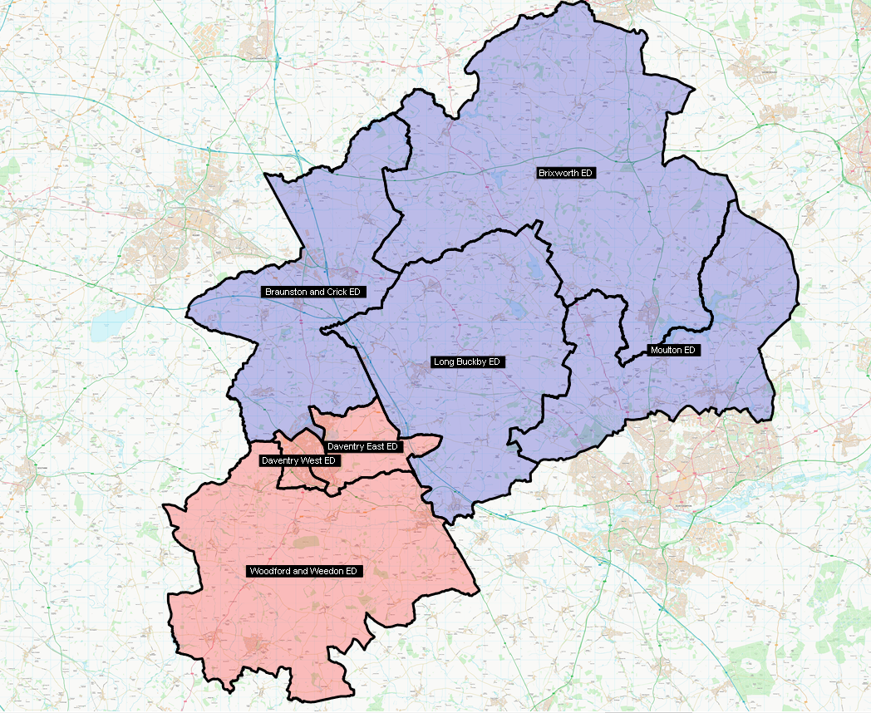
Daventry Sector
ND 2 - Brixworth & Moulton
Sgt 977 Lewis Judd
PC 718 Lee Stevens
PC Vacancy
PC 894 Wetherall
PCSO 7082 Lumbis
PCSO 7005 Barton
ND 3 - Crick & Long Buckby
Sgt 981 Harrison
PC 1705 Tyers
PC Vacancy
PCSO 7065 Egdell
PCSO 7161 Conopo (sponsored)
PCSO 7093 Cumming (sponsored)
Covering LAP
DSN1 & DSN2
Sector Inspector
Jonathan Davis-Lyons
Sector Co-ordinator
Penny Loveridge
Member of Parliament
Stuart Andrews
Councillors
TBC
ND 1 - Daventry
Sgt 981 Greg Harrison
PS 1388 Ellard (OP Fragment)
PC 1017 Townsend
PC 1570 Colton (Op Fragment)
PC 665 Morrow (Op Fragment)
PC 1176 Woodward
PC 1577 Morris
PC 143 Wills
PCSO 7184 Bates
PCSO 7032 Sangster
ND 4 - Weedon
Sgt 977 Lewis Judd
PC 1381 Galloway
PC 1070 Deacon-Pallett
PCSO 7012 Cooksammy
PCSO 7017 Miller (sponsored)

Slide 9
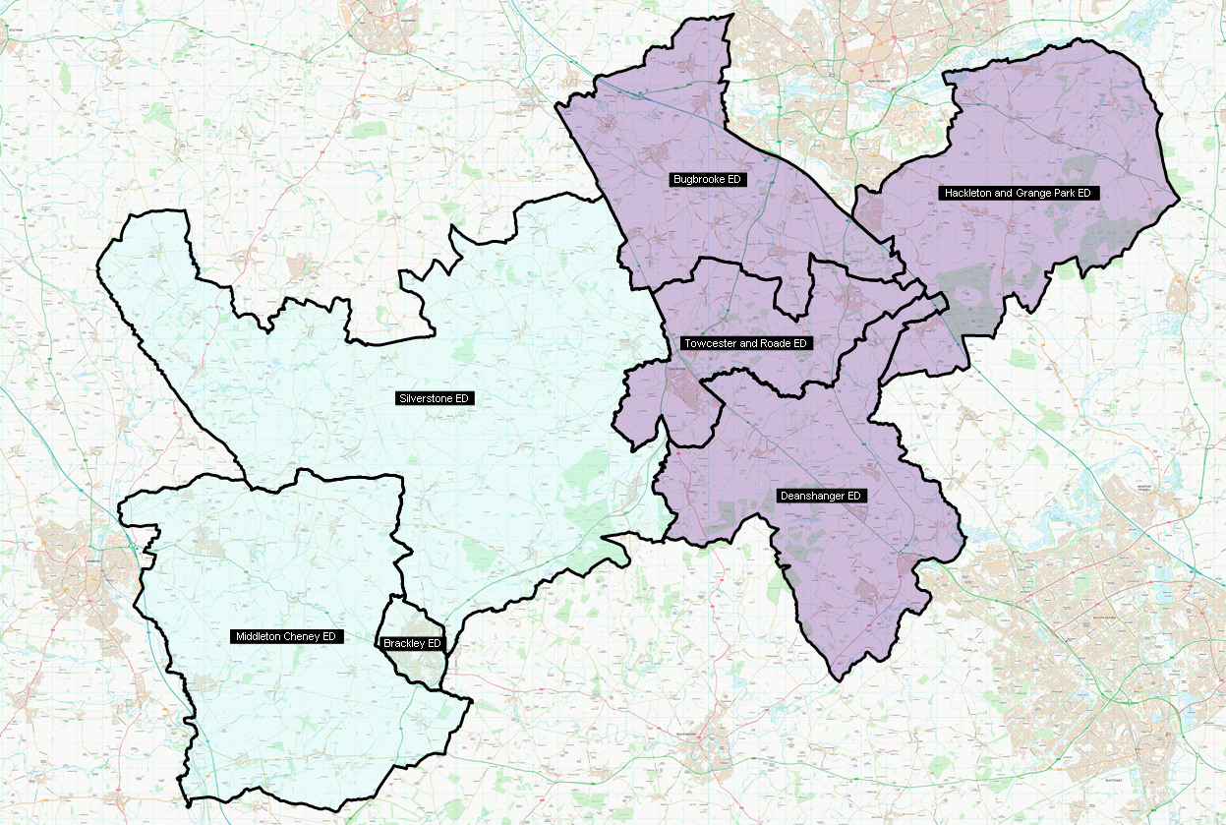
South Northants Sector
NS 3- Silverstone
Sgt 581 Simons
PC 1300 O’Brien
PC 801 Mitchell
PCSO 7182 Morgan
Covering LAP
DSN3 & DSN4
Sector Inspector
Jonathan Davis-Lyons
Sector Co-ordinator
Penny Loveridge
Member of Parliament
Sarah Bool
Councillors
TBC
NS 1- Deanshanger & Grange Park
Sgt 335 Clarke
PC 522 Partridge
PC 160 Rideout
PC 1675 Macovei
PCSO 7115 Taylor
PCSO 7139 Dudley
PCSO 7155 Teagles (sponsored)
NS 2- Towcester
Sgt 335 Clarke
PC VACANCY
PC 911 Carter
PC 1580 Fudge
PCSO 7029 Morris
PCSO 7040 Degg
NS 4- Brackley
Sgt 581 Simons
PC 1775 Sturgess
PC 1313 Mir
PCSO 7024 Brooks
PCSO 7041 Harrison

