Slide 1
Neighbourhood Policing
Fighting Crime
Protecting People

Slide 2
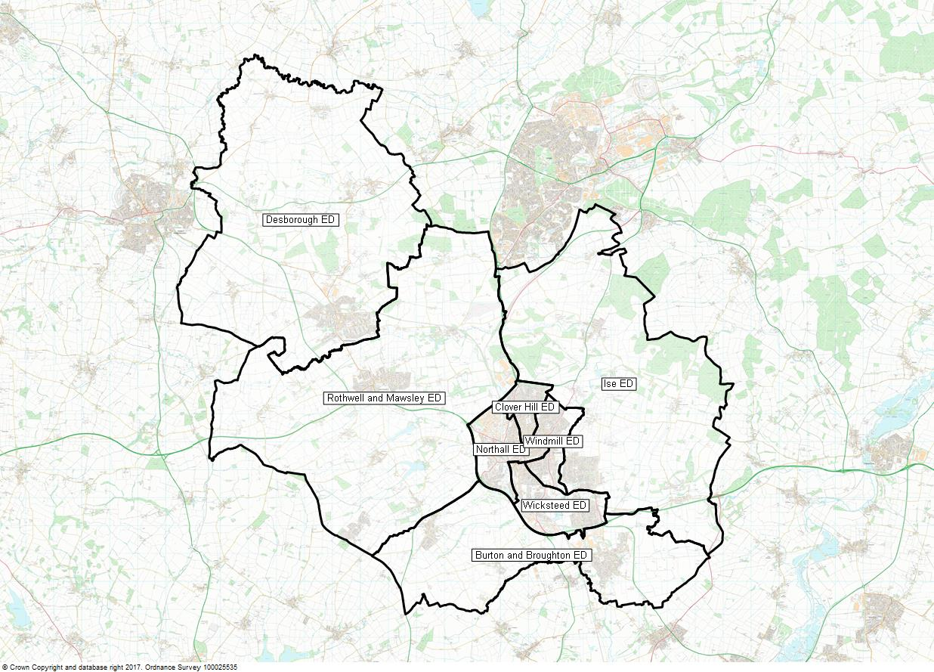
Kettering
Sector
NK 1- Kettering Central
Sgt 692 Rock
Sgt 142 McClean
PC Vacancy
PC 23 Booth
PC 854 York
PC 969 Cheatham
PC 412 Nottage
PC 1523 Batten
PC Vacancy
PC 1603 Underwood
PC 418 Bangs
PC 1576 Maltby
PCSO 7095 Loveday
PCSO 7144 Cotter
PCSO 7087 Brown
PCSO 7120 Dodd
PCSO 7099 Wright
NK 6- Desborough
Sgt 1156 Quinlan
PC 1355 Horsburgh
PCSO 7050 Ellerby
Sector Inspector
X0256 Paul Cash
Sector Co-ordinator
Julie McGreavey
Member of Parliament
Philip Hollobone
Councillors
TBC
NK 3- Ise
Sgt 1156 Quinlan
PC 1652 Donald
PCSO 7114 Meszes
NK 5- Rothwell & Mawsley
Sgt 1156 Quinlan
PC 509 Vickery
PCSO 7001 York
NK 2- Wicksteed
Sgt 692 Rock
Sgt 142 McClean
PC 216 Ryan
PC 1201 Hill
PC 1349 Walsh
PCSO 7130 Bowes
PCSO 7143 Chachulska
NK 4- Burton & Broughton
Sgt 1156 Quinlan
PC 83 James
PCSO 7191 Duggan

Slide 3
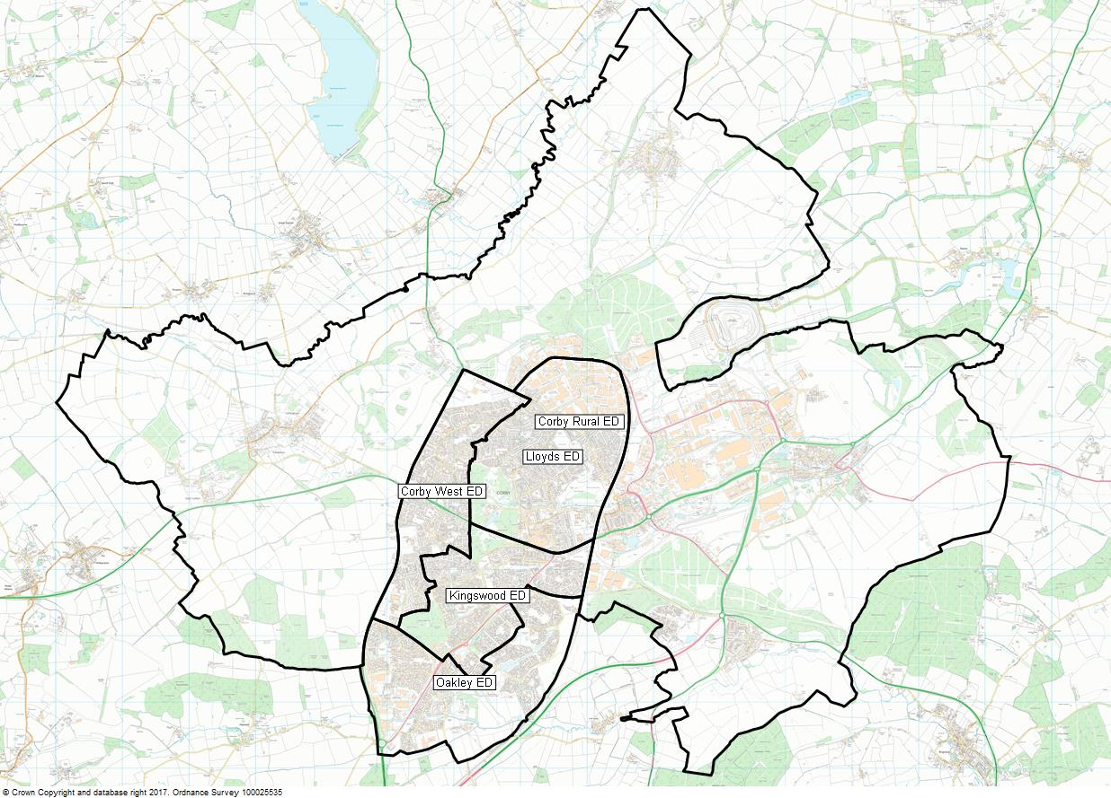
Corby
Sector
NC 1- Corby Town
Sgt 942 Cox
Sgt 225 Briggs
PC 1662 Callaghan
PC Vacancy
PC 925 Smith
PC 1640 Crabb
PC 1242 Brown
PC 0377 Cairns
PC 309 Campbell
PCSO 7215 Anderson
PCSO 7052 Baxter
PCSO 7149 Devlin
PCSO 7121 Greening
PCSO 7009 Panther
PCSO 7075 Goodes
PCSO 7045 Coles – School Liaison Officer
NC 2- Corby Industrial and Rural
Sgt 942 Cox
Sgt 225 Briggs
PC 820 Wilson
PCSO 7030 Asante-Ampaduh
Sector Inspector
X0256 Paul Cash
Sector Co-ordinator
Julie McGreavey
Member of Parliament
Tom Pursglove
Councillors
TBC

Slide 4
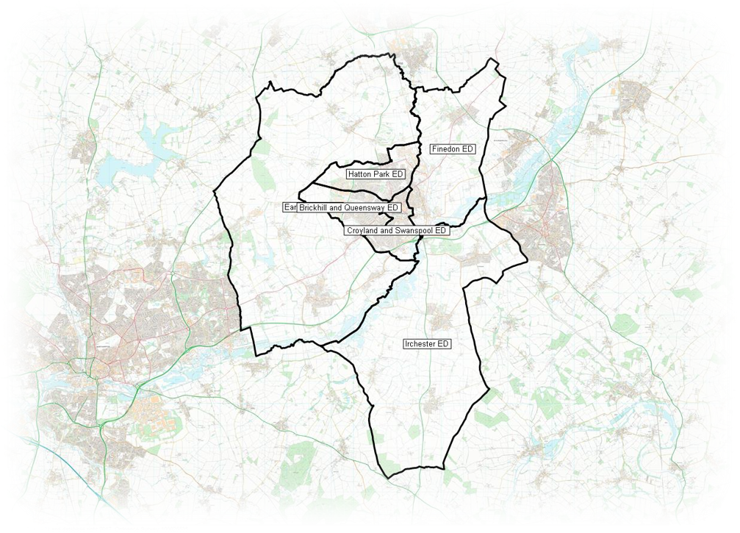

Wellingborough
Sector
NW 3- Finedon ​
Sgt 799 Nicola Nawaz ​
PC 135 Jack Wigmore
PC 109 Jason Manton -T1
PCSO 7053 Josh Horne
NW 5- Earls Barton ​
Sgt 799 Nicola Nawaz
PC 1285 Chris Foster – T3​
PCSO 7059 Gareth Cross – T1​
Sector Inspector
Miriam Kiernan
Sector Co-ordinator
Emily Philp
Member of Parliament
Peter Bone
Councillors
TBC
Wellingborough North​
Sgt 986 Gina O'Connor Frisby​
PC 1366 Danny Tyers – T3​
PC 1578 Wes Owen – T4​
PC Vacancy
PC 1690 Alex Barry
PCSO 7204 Wingrove
PCSO Vacancy
Wellingborough South​
Sgt 285 Baz Hughes
PC 1665 Marc Barnett – T2
PC 44 Lewis Desborough – T2​
PC 586 Josh Unsworth
PC 1486 Alin Chiriac
PC 444 Curtis Chambers
PC Vacancy​
PCSO 7086 Anzelika Krasovska
PCSO 7074 Ali Wallace – T4​
PCSO 7083 Phil Dobson – T2 ​
PCSO Vacancy
PCSO Vacancy
NW 4- Irchester ​
Sgt 799 Nicola Nawaz
PC 239 Mike Norman – T1​
PCSO 7163 Donna Fenner – T1​

Slide 5
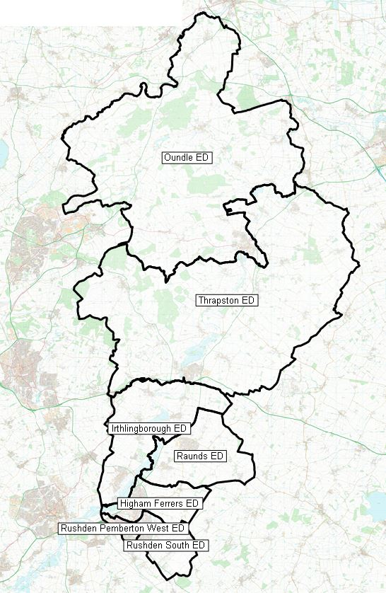
East Northants
Sector
EN 5- Oundle
Sgt 888 Goodwin
PC 441 Morgan
PCSO 7090 Pereira
EN 4- Thrapston & Raunds
Sgt 888 Goodwin
PC 991 Bristow
PC 80 Holmes
PCSO 7073 Butter
PCSO 7209 Thaseen
Sector Inspector
Miriam Kiernan
Sector Co-ordinator
Emily Philp
Member of Parliament
Tom Pursglove
Peter Bone
Councillors
TBC
EN 3- Irthlingborough
Sgt 888 Goodwin
PC 1537 Frost
PCSO 7186 Burrows
EN 1- Rushden
Sgt 888 Goodwin
PC 1651 Duncombe
PC 381 Feakin
PC 682 Bennett
PC Vacancy
PCSO 7100 Bryan
PCSO 7098 Littleton
PCSO 7019 Corbishley
PCSO Vacancy
EN 2- Higham Ferrers
Sgt 888 Goodwin
PC 1115 Carter
PCSO 7132 Gwilt

Slide 6
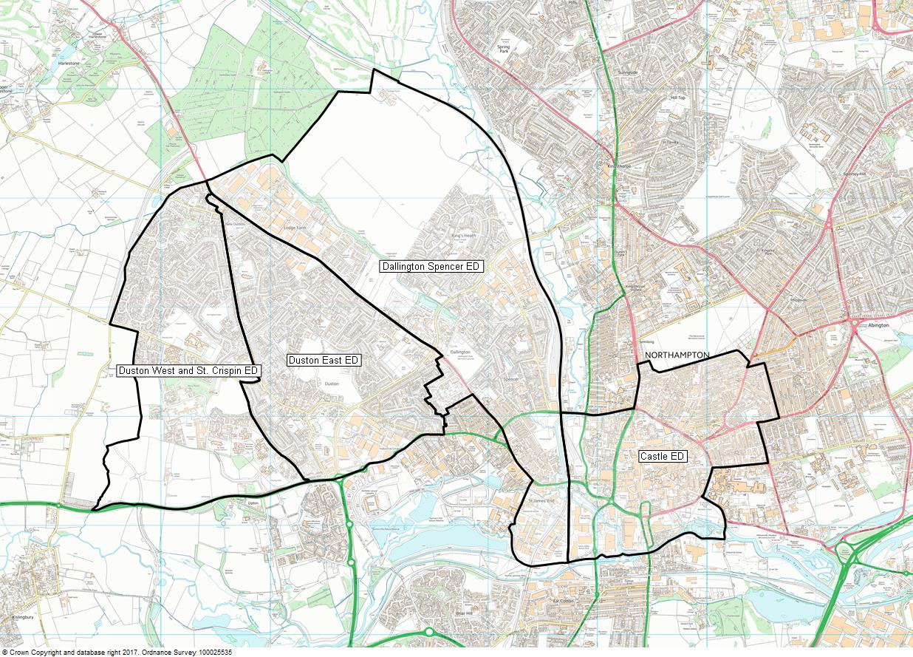
Northampton
Central
Sector
NN 2- Duston & Dallington
Sgt 22 Lindsay
PC 1691 Chamberlain
PC 26 Broom
PC 1089 Chaggar
PC 1702 Spencer
PCSO 7173 Emberton
PCSO 7158 Sereno
PCSO 7039 Urka
PCSO 7021 Pole
NN 1- Castle
Sgt 949 Dilley
PC 1972 Stirling (mat cover)
PC 1587 Cobb
PC 784 Burnham (mat)
PC 1280 Stone
PC 1169 Patel
PC 628 Manwaring
PC 1480 Barclay
PCSO 7025 Eales
PCSO 7094 Wilson-Townsend
Sgt 425 Salique
PC 1480 Barclay
PC 590 McCullen
PC 960 Perch
PC 1226 Wyburn
PC 1947 Willis
PC 193 Vale
PC 0894 Wetherall
PC 1762 Habeeb
PCSO 7174 Potter
PCSO 7016 Coote
PCSO 7148 Palur
PCSO 7049 Raygada
Sector Inspector
Beth Warren
Sector Co-ordinator
Clare Tinston
Member of Parliament
Michael Ellis
Andrew Lewer
Councillors
Castle
Jamal Alwahabi / Enam Haque / Danielle Stone
Dallington Spencer
Rufia Ashraf / Gareth Eales / Terrie Eales
Duston East
Paul Dyball / Nigel Hinch / Greg Lunn
Duston West & St Crispins
Matt Golby / Anna King / Jake Roberts
NN – UoN
Sgt 335 Clarke
PC 549 Buckby
PC 1371 Usher
PC 493 Juland
PC 837 Grimes
PC 541 Greenham
PC 837 Grimes

Slide 7
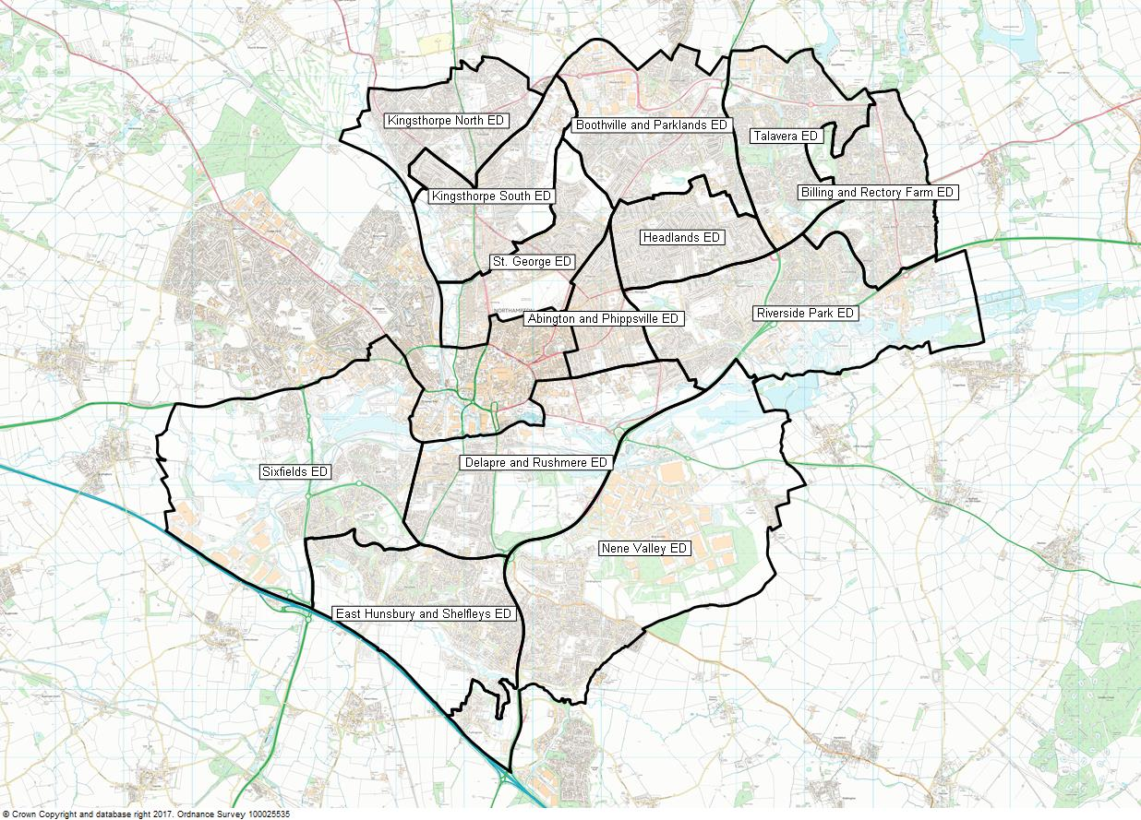
Northampton
Suburban
Sector
NN 3- East Northampton
Sgt 914 Wildman
PC 687 Ballin
PC 542 Jipa
PC 104 Davis
PC 1895 Lynch
PC Vacancy
PCSO 7072 Harrison
PCSO 7013 Hoadley
PCSO 7125 Nowell
PCSO 7057 Whiting
NN 8- Kingsthorpe
Sgt 1338 Roberts
PC 1981 Hilton
PC 701 Cottle
PC 1492 Govind
PC 1483 T Cardell
PCSO Vacancy
PCSO 7198 Barber
PCSO 7196 Bednarczyk
Sector Inspector
Nicola Davis-Lyons / Rodney Williams
Sector Co-ordinator
Clare Tinston
Member of Parliament
Michael Ellis
Andrew Lewer
Councillors
Abington & Phippsville
Bob Purser / Zoe Smith / Walter Tarasiewicz
Billing & Rectory Farm
Paul Clark / James Hill / Keith Holland-Delamere
Boothville & Parklands
Mike Hallam / Jamie Lane / Laura Stevenson
Delapre & Rushmere
Raymond Connolly / Julie Davenport / Emma Roberts
E Hunsbury & Shelfleys
Pinder Chauhan / Andre Gonzalez De Savage / Suresh Patel
Headlands
Koulla Jolley / Paul Joyce / Mark Hughes
Kingsthorpe North
Aziz Rahman / Michael Brown / Sam Rumens
Kingsthorpe South
Harry Barrett / Cheryl Hawes / Sally Beardsworth
Nene Valley
Lizzy Bowen / Phil Larratt / Jonathan Nunn
Riverside Park
Penelope Flavell / Stephen Hibbert / Andrew Kilbride
St George
Muna Cali / Cathrine Russell / Winston Strachan
Talavera
Nazim Choudary / Janice Duffy / Dennis Meredith
Sixfields
Imran Ahmed Chowdhury / Brian Sargeant / Nick Sturges-Alex
NN 7- St George
Sgt 1254 Moston
PC 889 Scott
PC 1054 Longrigg
PC 1298 Noon
PC 0647 Kitson
PCSO 7116 Matthews
PCSO 7096 Singh
NN 4- Riverside Park
As above East Northampton
NN 6- Delapre / South Northampton
Sgt 867 Morris
PC 955 Okere
PC 0967 Lee
PC 61 Butler
PC 1653 Elliott
PC 527 Silver
PCSO 7092 Parris
PCSO 7122 Hopper-Hall
PCSO 7137 Earl
PCSO 7168 Evans
PCSO 7104 Shelton
PCSO 7124 Hurst (Sponsored)
NN 5- Abington & Boothville
Sgt 1254 Moston
PC 1337 Barnes
PC 451 Werdekker
PC 1481 Watson
PCSO 7177 Foster
PCSO 7150 Freeman

Slide 8
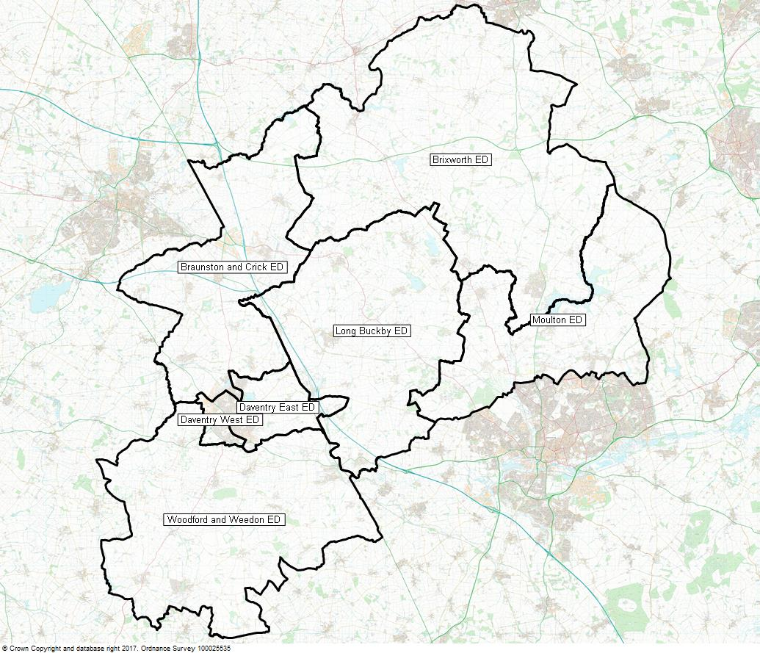
Daventry
Sector
ND 2- Brixworth & Moulton
Sgt 658 Moore
PC 718 Lee Stevens
PC 1178 Bates
PCSO 7082 Lumbis
PCSO 7145 Wright
PCSO 7017 Miller (sponsored)
ND 3- Crick & Long Buckby
Sgt 981 Greg Harrison
PC 1705 Tyers
PCSO 7065 EGDELL
PCSO 7161 CONOPO (sponsored)
PCSO 7093 Cumming (sponsored)
Sector Inspector
Dave Wakeman
Sector Co-ordinator
Penny Loveridge
Member of Parliament
Chris Heaton-Harris
Councillors
TBC
ND 1- Daventry
Sgt 981 Greg Harrison
PC1161 Faint
PC 1570 Colton
PC 1176 Woodward
PC 1577 Morris
PC 879 Martin
PCSO 7184 Bates
PCSO 7032 Sangster
PCSO Vacancy (Sponsored)
ND 4- Weedon
Sgt 658 Moore
PC 1381 Galloway
PCSO 7012 Cooksammy
PCSO 7005 Barton (sponsored)

Slide 9
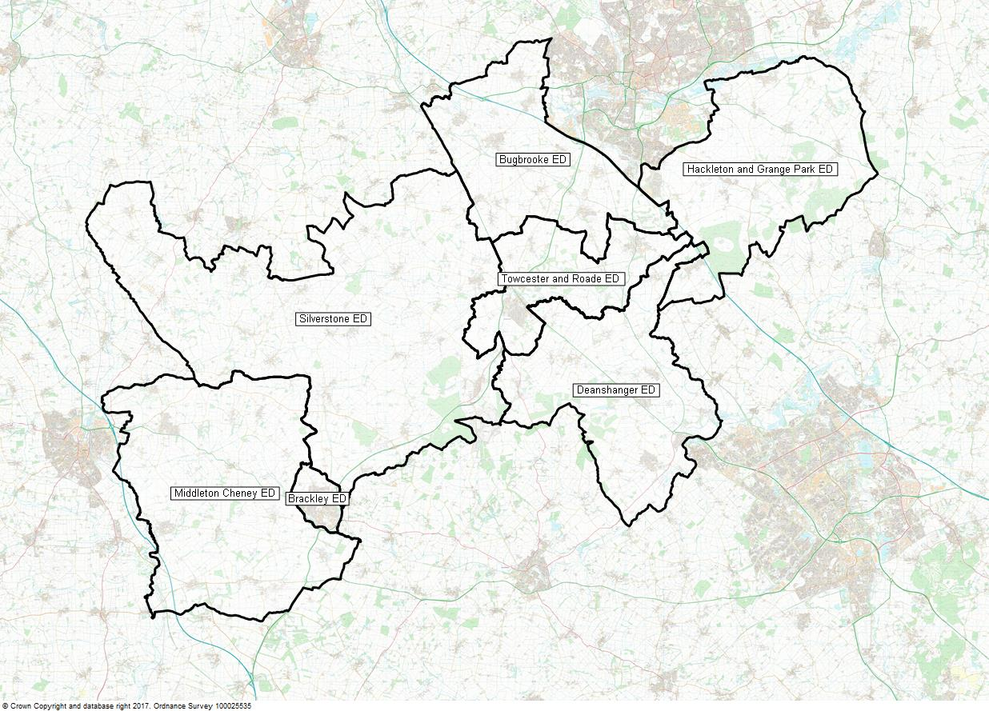
South Northants
Sector
NS 3- Silverstone
Sgt 581 Simons
PC 911 Carter
PC 801 Mitchell
PCSO 7182 Morgan
Sector Inspector
Dave Wakeman
Sector Co-ordinator
Penny Loveridge
Member of Parliament
Andrea Leadsom
Councillors
TBC
NS 1- Deanshanger & Grange Park
Sgt Greg Taylor
PC 860 Bird
PC 160 Rideout
PCSO 7115 Taylor
PCSO 7041 Harrison
PCSO 7139 Dudley (sponsored)
NS 2- Towcester
Sgt Greg Taylor
PC 875 King
PC 1388 Ellard
PCSO 7029 Morris
PCSO 7040 Degg
NS 4- Brackley
Sgt 581 Simons
PC 1183 Smith
PC 1649 Mackenzie
PCSO 7023 Jones
PCSO 7024 Brooks

